Slide 1



Java Project

Slide 2
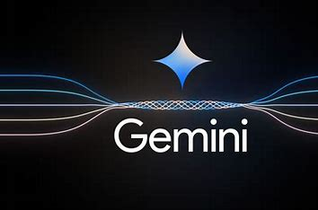
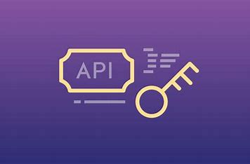
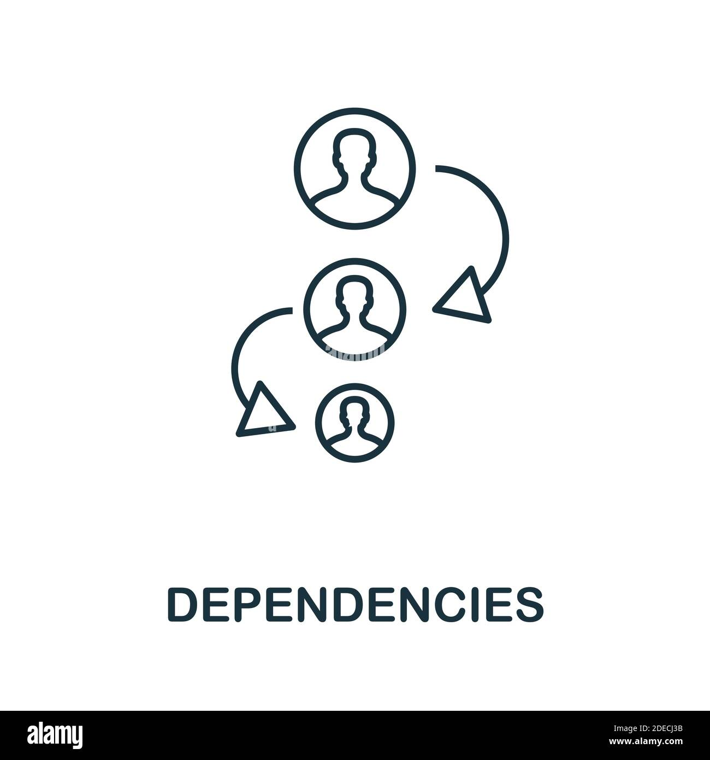
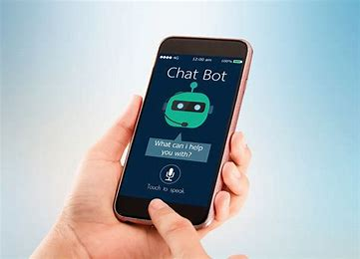
Our Goal
1.Generate Gemini API key
2.Integrate API KEY To JAVA
.
2.Add Dependencies
.
3. Use this Chatbot anywhere
.

Slide 3


WHAT WE CREATED
WE created an AI Chatbot that is infinitely customizable by a user. It is operates and returns answers faster than any other AI chatbot out for competition. We did this by using an API of Gemini AI chatbot and its key. We integrated this Gemini API with java to create our own user interface.

Slide 4
An AI chatbot is a computer program that can talk to people using text or voice. It uses artificial intelligence (AI) to understand what someone is saying and respond in a helpful or friendly way. You can find AI chatbots on websites, apps, or even in smart devices. They are used for many things, like answering customer questions, helping with online shopping, booking tickets, or just having a fun chat.AI chatbots learn from a lot of information and improve over time. Some chatbots are very basic and can only give short, simple answers. Others are more advanced and can hold long conversations, tell jokes, write stories, or even help with homework!People like AI chatbots because they are fast, always available, and don’t get tired. They help make life easier by saving time and giving quick support when needed.

Slide 5

HOW ITS DONE??
STEP 1: Set up a Google cloud project.
STEP 2: Generate an API Key.
STEP 3: Add the required dependencies in JAVA
STEP 4: Write the code to call the Gemini API Key.

Slide 6

Company Name
API KEY

Slide 7

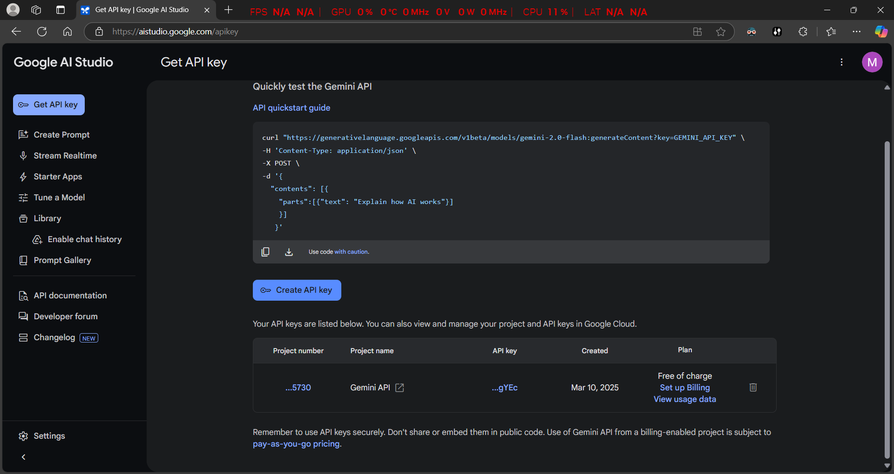
What is API?? API is short for Application Programming Interface. It is a set of rules and protocols that defines the methods and data formats that different applications can use to request and exchange data. In short API acts as a 3rd party broker that forms the middle man between two or more softwares.
API

Slide 8


Slide 9
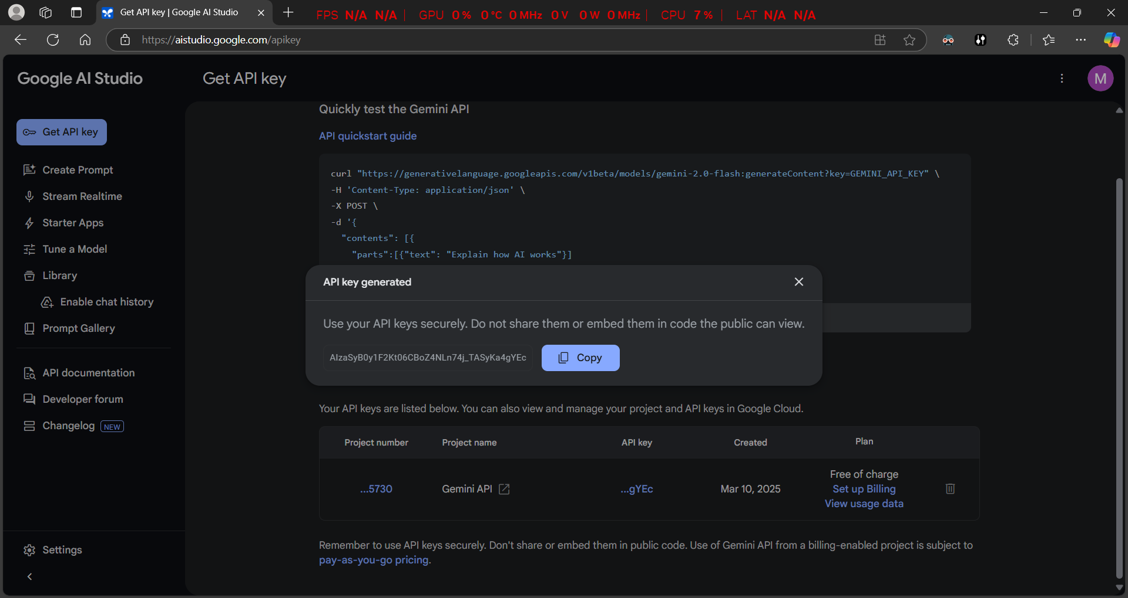
An API Key is a unique identifier used to that corresponds to a certain program application. The API key is like a password that allows you to use the API. It’s purpose is to identify the applications that are being integrated and authenticate its request as coming from you as a user.
API KEY

Slide 11

INTEGRATE API KEY TO JAVA
This is the most crucial part of the program. This is done using several dependencies that integrate our java code to the API and the wider internet.

Slide 12
DEPENDENCIES
USED
javax.swing : used to create GUI
java.awt : used to work with elements at a lower level. Like for customizations and event handling.
java.net.URI : used to create the manipulate Uniform Resource Identifiers and thus create API request URL.
java.net.http : used to integrate http client server into java. Sends http request and receives response.
java.util.ArrayList : provides dynamic array for storing query and response history.
Java.util.List : provides interface for working with collection of elements.

Slide 13
Company Name
javax.swing
javax.swing is a part of the Java Swing library that is used to build Graphical User Interface for desktop applications. This library is not attached to the native GUI of any device and also provide a large variety of classes and functions to customize their application. This makes it the best library to be used for several application building with Java.

Slide 14
Company Name
javax.awt
awt stands for Abstract Window Toolkit. It provides classes and tools for creating and managing Graphical User Interface components. It works on a much lower level on elements compared to swing. It also provides platform independent GUI components and yet depends on the operating systems native GUI thus making application consistent with various operating systems.

Slide 15
Company Name
javax.net.URI
This class in Java represents Uniform Resource Identifier. A URI is a string of characters that can uniquely identify a resource on the web or elsewhere. This class is platform independent and flexible enough to support relative and absolute URIs thus best for creating applications that can work seamlessly across any device.

Slide 16
Company Name
javax.net.http
This Java package is a modern HTTP client API designed to simplify making HTTP requests and handling responses. The showcase features of this package are cross platform compatibility, enhanced performance and least latency.

Slide 17
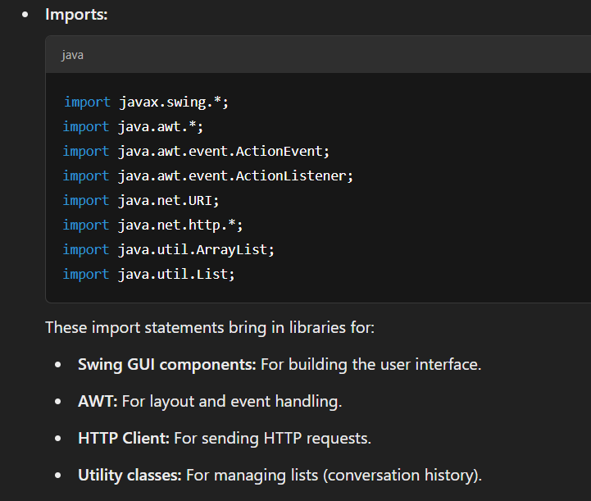

Slide 18
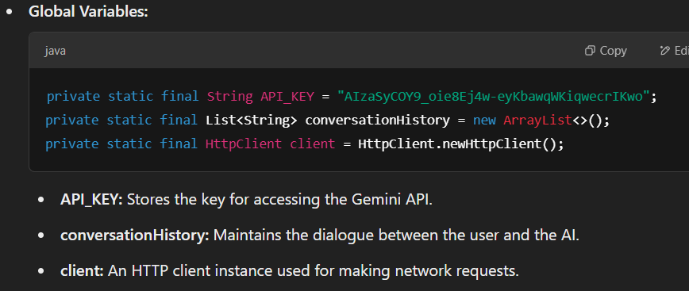

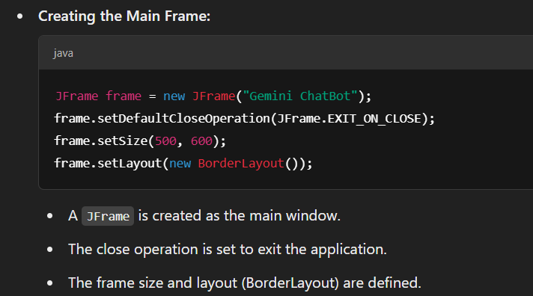

Slide 19

Implementation of Ai in the Live Server
First we converted our Java source code to html, so that it could be run on any device without the complexitites of libraries or extensions.
In this case to demonstrate on your devices we are using IP forwarding/ Port forwarding method In this you have to connect to Same Wi-fi Network… Enter the { 10.21.XXX : 5500} in your Browser URL

Slide 20
Differences Gemini ChatBot (Java + Google Gemini API) vs Other Popular AI
Feature | Our ChatBot | Other Popular AI Systems
Development Platform | Java with Swing UI, cross-platform | Python or cloud frameworks, rapid prototyping
API & Model Used | Google Gemini API (v1beta, gemini-1.5-flash) | Models like GPT-3/4, IBM Watson, Microsoft LM
Integration & Customization | Custom API integration, manual context | SDKs with templates, native context handling
User Interface | Desktop app with Swing UI | Web, mobile, or embedded with modern frameworks
Cost & Licensing | API usage cost, manage billing/quotas | Subscription, pay-as-you-go, or open-source
Scalability & Deployment | Manual scalability (multi-threading, etc.) | Automatic scalability via cloud
Security | Custom security for API keys and data | Integrated security (authentication, encryption)

Slide 21

Future implementations on this Project could be.
Improved Conversation Memory:
User Personalization:
Multi-Platform Support:
Integration with External Services:
Enhanced Error Handling & Security:.
Analytics & Reporting:.
Modern UI/UX Enhancements:

Slide 22
CHALLENGES AND FIXES
No Input Validation or Sanitization. ie the input is not. Unexpected input, like very long text or special characters, could cause API or display problems.
Hardcoded API Key. To keep the API key safe, it could be stored it externally and load it securely when the program runs. Simplified JSON Parsing
Simplified JSON Parsing. Extracting the response from the API is simplified. This could cause run-time errrors when API is updated. Fixed by using a robust JSON parsing library.

Slide 23
Conclusion
Successful Development: Our Java AI chatbot, built using an AI API, demonstrates the effective integration of artificial intelligence into a Java application.
Key Features: Its capabilities, such as natural language understanding and adaptive responses, showcase its potential to enhance user interaction.
Technical Achievement: This project highlights the synergy between Java’s robustness and advanced AI technologies provided by the API.
Much Future Potential: It lays the foundation for further exploration and innovation in AI-driven Java applications.

Slide 24
1
TIMELINE
PROJECT ANALYSIS: Understand the Project
2
UI DESIGN : Finalizing and Creating a Design
Integrate API, Memory Storage and UI
3
4
TRAIL AND ERROR: Test Running the Code and Fixing Errors

Slide 25

The team
AIE 24154 - RIYAN SUNILDETH
AIE24151 - RAHUL
AIE24141 - JEEVAN
AIE24103 - MUKHESH
AIE24129 – RAM TEJA

Slide 26


